Slide 1
GIT
GITHUB
Installed locally on the system.
Git can be used offline & does not need any internet connection for use.
Git can be used without GitHub.
Used for version control and code sharing.
There is no GUI. ( No Graphical User Interface )
Code Changes like commit , merge , etc.. Are done by using command line.
Open source licensed.
Competitors - Mercurial, Supervision , IBM , Rational Team Concert and Clear Case. .
Hosted on cloud.
GitHub cannot be used offline and needs an internet connection.
GitHub cannot be used without Git.
Used for centralised source code hosting.
It provides an easy to use GUI.
Everything is done through a web-based interface.
Includes a free and pay for use tiers.
Competitors – Atlassian Bit Bucket & Git Lab

Slide 2
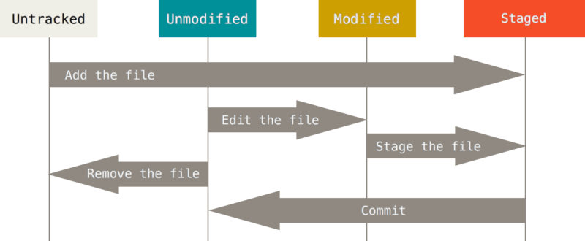

Slide 3
